Slide 1
Visualizing Deep Neural Network Decisions: Prediction Difference Analysis
Authors: Luisa M Zintgraf, Taco S Cohen, Tameem Adel, Max Welling
Published as a conference paper at ICLR 2017
Presentation by Michael Lan

Slide 2
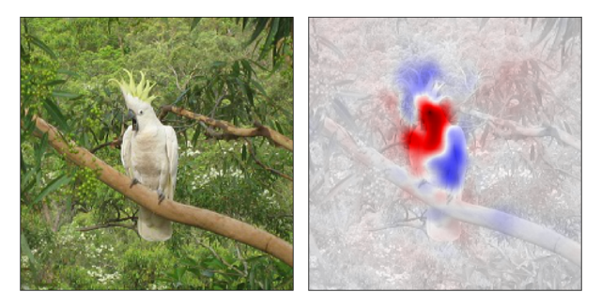
Introduction
This paper presents a method to visualize a neural network’s response to an image. The method highlights areas in the input that provide evidence for (red) or against (blue) a certain class.

Slide 3
Medical Application
This method was applied to a classifier trained on MRI brain scans of HIV patients with a neurogenerative disease. This classifier predicts if a patient has HIV or not.

Slide 4
Problem + Solution
EXISTING PROBLEM: Typically, clinicians do not know which regions of an image influence a classifier’s prediction.
WHY THIS METHOD IS A SOLUTION:
It would allow clinicians to figure out which regions of an MRI scan provide evidence for/against a patient having a certain disorder.
Clinicians will be able to cite more detailed evidence for how the classifier affects their diagnosis decisions.

Slide 5
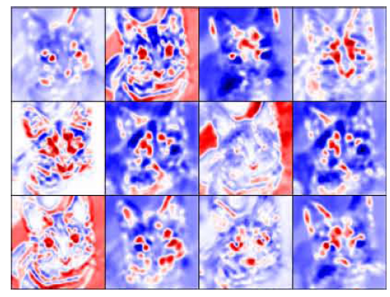
Additional Novel Applications (for Convolutional NNs only)
Method shows how nodes in a feature map (a filter’s activations) from hidden layer L affect nodes in a FM from hidden layer L+1
Shown: 12 feature maps of a layer
Eg) Top-left box shows which
pixels (in red) of input image
activate top-left feature map, and
which pixels (in blue) decrease
the activation

Slide 6
Outline of Talk
Previous Related Work
Introduction to Method: Prediction Difference Analysis (PDA)
Evaluation Metric: Weight of Evidence
3 Changes to PDA made in this paper
MRI and ImageNet Results
Comparison to previous method “Class Saliency Visualization”

Slide 7
Previous Related Work
2 APPROACHES to understanding a neural network through visualization
Approach 1: Generate/alter an input image using gradient ascent to maximally activate a given node/class score
“Visualizing Higher-Layer Features of a Deep Network” (Erhan et al, 2009) was an early pioneer of this approach. “Visualizing Image Classification Models and Saliency Maps” (Simonyan et al, 2013) applied this to ConvNets. Deepdream is another type of technique with this approach.

Slide 8
Previous Related Work
Approach 2: Visualize how network responds to a SPECIFIC input image to explain a particular classification made by the network. This paper uses the 2nd approach.
(Simonyan et al, 2013) used ‘Class Saliency Visualization’, which is related to Deconvolutional networks from the paper “Visualizing and understanding convolutional networks” (Zeiler and Fergus 2014).
This paper is novel because it applies a technique called Prediction Difference Analysis to feature visualization; the authors claim this is a more rigorous approach than certain previous methods

Slide 9
Previous Related Work
Additionally, a reviewer noted that, contrast to previous work, this paper has the key insight that the more important features are ones that 1) maximally change the output and 2) are more unpredictable from other features
“Most previous work has focused on finding features that maximally change the output without accounting for their predictability from other features.”
https://openreview.net/forum?id=BJ5UeU9xx

Slide 10
Previous Related Work
Feature Visualization for Medical Image Classification: Papers such as “Describing the brain in autism in five dimensions” (Ecker et al, 2010) usually just plot the weights of a linear classifier. But some argue, as in “On the interpretation of weight vectors of linear models in multivariate neuroimaging” (Haufe et al, 2014), that these interpretations are misleading.
It will be shown in the Experiments section of this talk that this paper’s method is clearer than weight plotting at showing which features contribute more to classification

Slide 11
Explanation of Method: Introduction
This paper’s method is based on a method by Robnik-Šikonja & Kononenko (2008). The original method is called “Prediction Difference Analysis” (PDA)
Can be applied to any image classifier neural network, not just Convolutional NNs

Slide 12
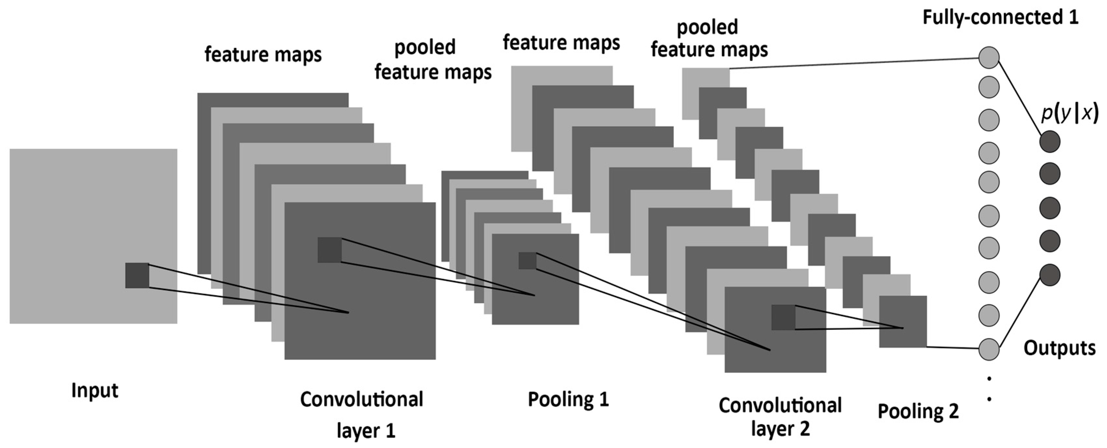
Explanation of Method: Introduction
This presentation mentions feature x_{i} . When applying method to CNN, note that each pixel x_{i} is a feature (it is the lowest level feature), so each “feature” refers to a pixel in the input image.

Slide 13
Explanation of Method: Introduction
Nodes in hidden layers are also considered features, but are not called pixels.

Slide 14
Prediction Difference Analysis
This method measures how RELEVANT a feature x_{i} is for predicting whether an image is in class C or not. Let x = vector of features.
Let = probability the image is in C given features
Let = probability the image is in C given features WITHOUT FEATURE x_{i}
Relevance( x_{i} ) : –
How will p(c) change when feature x_{i} is missing?

Slide 15
Prediction Difference Analysis: How it was developed in response to issues
ISSUE #1: How to calculate ?
SOLN: Sum together probabilities p(c | x) that are over x_{i}. This is called ‘marginalizing’, as it calculates the probability that is only over the subset (margin) of variables

Slide 16
Prediction Difference Analysis: How it was developed in response to issues
ISSUE #2: Calculating is infeasible for many # of features
SOLN: Assume x_{i} is independent of so =>
Approximate p(x_{i} ) too. Use sample distribution of x_{i}

Slide 17
Prediction Difference Analysis: How it was developed in response to issues
ISSUE #3:
Relevance is a difference between probabilities, but it is not a probability itself. Thus, it is allowed to be negative. But then Relevance has no rigorous foundation, so how do you interpret it? You use it to say “x_{i} supports class C” but in what way? It doesn’t make the image “more likely” to be class C.
SOLN: Use the rigorously defined measure “Weight of Evidence” (WOE), which can be formulated as the ratio between odds ratios.

Slide 18
What does odds ratio describe?
Odds(c | x) describes HOW MUCH “image in C” is favored over “image not in C”. For example, odds=80/20 means “being in C” is 4 times as more likely to occur than “not being in C”.
Odds ranges from 0 to infinity, so odds between 0 and 1 mean “being in C” is less favored. Ratio of odds is also between 0 and 1. Can we find a more intuitive measure that uses – and + instead?

Slide 19
Weight of Evidence
Yes: take log(odds) to get Weight of Evidence for each feature x_{i} :
WE(i) > 0: Having x_{i} INCREASES chances of image being in C
WE(i) < 0: Having x_{i} DECREASES chances of image being in C
Relevance vector WE: contains WE for every feature

Slide 20
Weight of Evidence
WOE can be formulated in terms of probabilities, but odds feel more intuitive to compare how much X contributes to classification
The paper uses odds is because it was used by the method’s original paper. In the original paper, odds was used because: “It may not be wise to use the difference between probabilities directly, without normalization, as humans are known not to be very good at comprehension and evaluation of probabilities” - Robnik-Šikonja & Kononenko (2008).
WOE was rigorously defined in the book “Probability and the Weighing of Evidence” by Jack Good (1950).

Slide 21
Change #1 from PDA: High-level feature removal
The original method only removes 1 pixel to calculate the change in prediction. But neural networks likely won’t suffer losses in accuracy when just 1 pixel is removed. How can we remove higher level features- sets of connected pixels, such as an entire vase?
Thus, this paper removes K x K patches using overlapping sliding windows
For 3D MRI images, these are K x K x K patches

Slide 22
Change #2 from PDA
To calculate an approx. to Marginal Dist. , it was assumed that each pixel was independent of others. But they aren’t! Pixels aggregate to form objects in images!

Slide 23
Change #2 from PDA
Observe that a pixel depends on its patch neighbors, but this patch of neighbors does not depend on its position in the image
(Eg. a vase is a vase because of how its pixels are arranged in a shape, not on the fact that the vase is in the bottom right of an image)
Thus, we can approximate by using conditional sampling on the neighbors of x_{i}

Slide 24
Change #2 from PDA: Conditional Sampling
For each pixel x_{i}, we can find a patch of size L x L that contains x_{i}
Thus, to approximate , measuring how likely a pixel will take on a certain value given every other pixel in the image, we can shrink the set of pixels x_{i} depends on to just its immediate neighbors
This approximation is tractable and is carried out using conditional sampling from a normal distribution

Slide 25
Illustration of the Two Changes

Slide 26
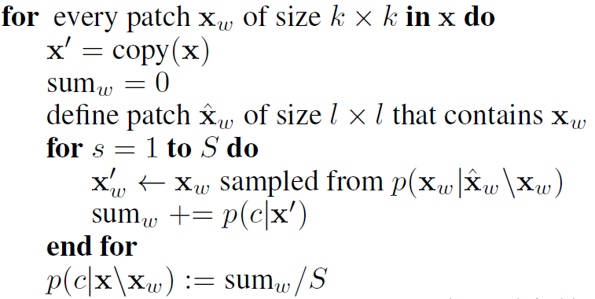
Change #2 from PDA: Conditional Sampling
Conditional Sampling is a procedure that can be used when sampling from a distribution such as is hard, but sampling from a smaller distribution such as is easier

Slide 27
Change #2 from PDA: Conditional Sampling
Calculate p(c | x’) by running classifier on the patch of image features x’ (later, I will point out a typo)

Slide 28
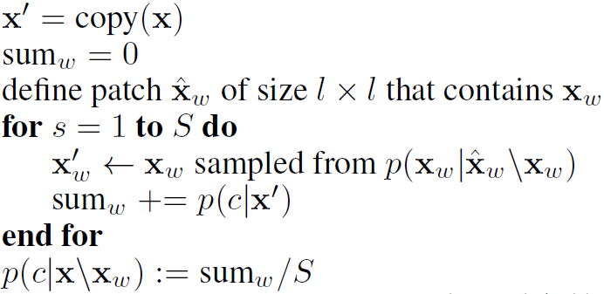
Change #2 from PDA: Conditional Sampling

Slide 29
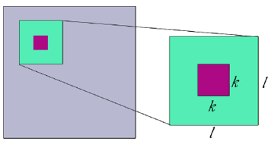
Change #2 from PDA: Conditional Sampling
Typo: p(c|x’) should be p(c | x_{w}’). Run classifier only on samples taken from simulated distribution created from empirical ; that is, on sample features from green but NOT purple or grey (see above)

Slide 30
Change #2 from PDA: Conditional Sampling
Equation also supports idea of Typo: p(c|x’) → p(c | x_{w}’)

Slide 31
Change #2 from PDA: Conditional Sampling
Algorithm: run p(c| x_{w}’) multiple times, each on only 1 sample of the patch, then take the average of multiple p(c| x_{w}’)
Github Code: classifier runs a forward pass (with batching) on all samples of a patch at once to get multiple values of p(c | x_{w}’). Then the program takes average of these to get

Slide 32
Steps for conditional sampling
1. For every feature, get its k-patch. L = k+(# neighbors)
2. Create a multivariate normal distribution using the mean + covariance matrix of that L-patch’s sample distribution
3. For every feature in k-patch, draw S samples from this normal distribution. So now we have k*S values
4. Run trained classifier’s forward pass on these k*S values to obtain multiple values of p(c | x_{w}’)
5. Take their average to get

Slide 33
2. Create a multivariate normal distribution using L-patch’s sample distribution

Slide 34
3. For every feature in k-patch, draw S samples from this normal distribution
Feature_sets is the # of neighboring features in the k-sized window, the multiple features selected as a patch (NOT the sampling space, which is LxL). It is used to calculate the multivariate normal distribution from which samples will be drawn

Slide 35
4. Run trained classifier’s forward pass on these k*S values

Slide 36
5. Take the average to get

Slide 38
Change #3 from PDA: How nodes in a hidden layer affect nodes in deeper layers
Let h be the vector representation of the nodes in a layer H in the network (after forward-propagating the input up to this layer)
Let z = z(h) be the value of a node that depends on h. Let be the distribution of layer H+n node z when node h_{i} is missing

Slide 39
Experiment Results from MRI
COBRA dataset: 3D MRIs from 100 HIV patients and 70 healthy individuals. 91 x 109 x 91 = 902,639 voxels
Trained an L2-regularized logistic regression classifier on a balanced dataset (70 HIV, 70 healthy)
69.3% accuracy on 10-fold cross validation test
All experimental results (on both MRI and ImageNet data) used S = 10 samples. Conditional sampling was done from a multivariate normal distribution. As shown later in talk, only conditional sampling was used because it outperformed marginal sampling

Slide 40
Experiment Results from MRI
The following visualizations for the next 3 slides are all from one 3D MRI image, using patch sizes k =3 and L = 7
Since the image is in 3D, every 2D visualization is a 2D slice of the 91 x 109 x 91 3D image along the 1st axis. Thus, there are 91 possible slices.
Each image took ~30min to run through the paper’s algorithm on a CPU

Slide 41
Left (black) is MRI overlayed with relevance values from paper’s method. Right (white) shows values when the classifier takes in the image with inverted colors. Red pixels are “for”, blue are “against”.
Confusing part of paper: Relevance values are only shown for voxels with absolute relevance value > 15% of the absolute maximum value. But how can value be > than maximum??? My guess is they mean only top 15% relevance values (for/against) are shown

Slide 42
This DOES NOT USE paper’s method and uses the weights of the Logistic Regression classifier. Compared to PDA, voxels are more scattered, and thus harder to use when figuring out which regions contribute to classification.

Slide 43
This is the same image with inverted colors, but instead of just showing slices 29 and 40, it shows relevance values on more slices

Slide 44
Slice 39 from 4 different sample images. All images were correctly classified. HIV patients tend to have more red at the bottom; other patterns can be spotted that distinguish the 2 classes

Slide 45
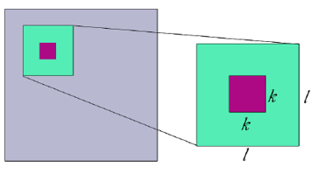
How patch size k influences the visualization. Input image is an HIV sample, slice 39. Lower k gives finer insight, higher k gives broader
Clinicians can vary slices and patch
size to obtain different insights

Slide 46
Experiment Results from ImageNet
3 DCNN classifiers (AlexNet, GoogLeNet, and VGG-16) trained on ILSVRC challenge, a large dataset of images from 1000 categories
Applying method on 1 image took 20, 30 and 70 mins respectively for each trained network
Caffe on GPU with mini-batches, k = 10, L = k + 4

Slide 47
Experiment Results from ImageNet
Conditional sampling was shown to be better than marginal sampling because it gives more targeted explanations. Also, marginal focuses too much on pixels outside the object of interest (as seen in the saxophone). Below shows the comparison done on GoogLeNet:

Slide 48
Experiment Results from ImageNet
Increasing k smooths out the relevance value clusters, but makes them more blurry. k = 10 gives a good trade-off between sharp results and a smooth appearance
It was found, contrary to expectations, that removing even 1 pixel could have an effect on the classifier

Slide 49
Experiment Results from ImageNet
3 collections of feature maps from 3 different layers (early to later) of GoogLeNet. Each cell in a collection is a feature map.

Slide 50
Edges

Slide 51
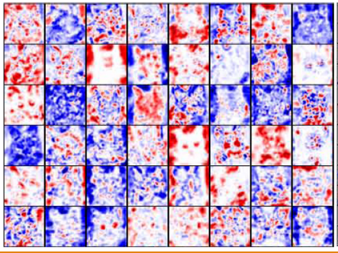
Faces

Slide 52
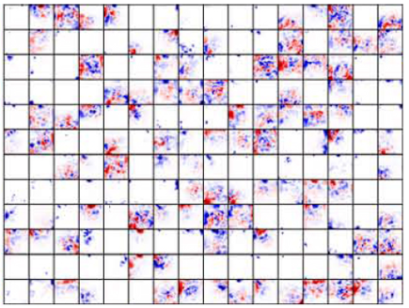
Specialized

Slide 53
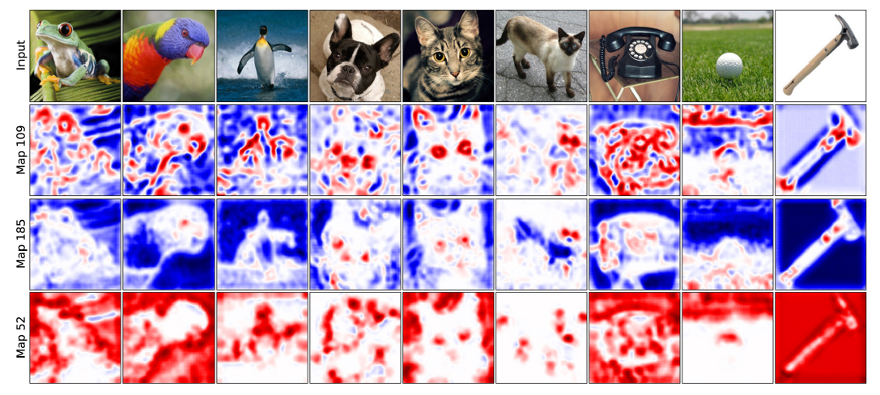
3 different feature maps for various images from middle layer of GoogLeNet. Map 185 (3rd row) seems to have learned to use eyes to classify images.

Slide 54
Visualization of pre-softmax (2nd last) and softmax (last) layers
Shows only the evidence for/against this particular class, without taking other classes into consideration.
Images in pre-softmax all share similar pattern, suggesting they capture the abstract pattern of “elephant” but not specific elephant type

Slide 55
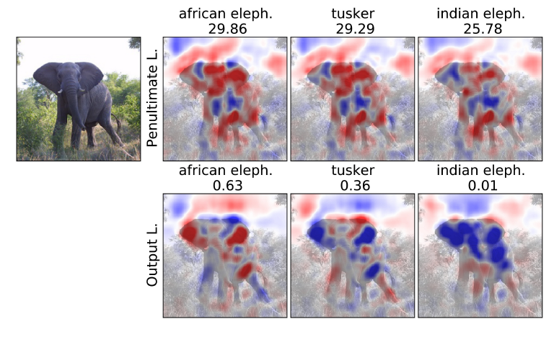
But once get to output layer, classifier can distinguish between different elephant types using their ears

Slide 56
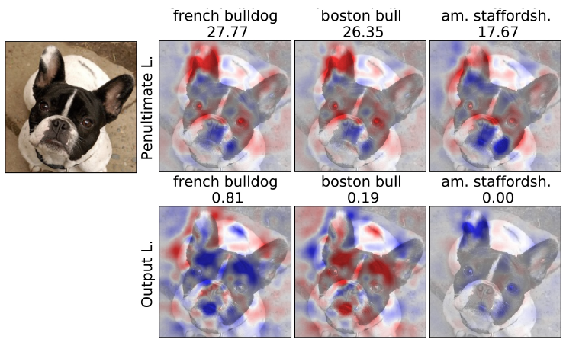

Slide 57
AlexNet seems to more on contextual information (the sky in the balloon image). This may be because it has the least complex architecture amongst the 3 networks.
VGG network assigns much importance to the balloon basket. The second highest scoring class in this case was a parachute. Perhaps the network learned to not confuse a balloon with a parachute by detecting a square basket (and not a human).

Slide 58
Comparison to Class Saliency Visualization (Simonyan et al, 2013)
Left col shows old method, middle is
original image, right is paper’s method
Red in left col means ‘sensitive to
classfication’
This paper’s method appears to
achieve more intuitive explanations
All are correctly classified

Slide 59
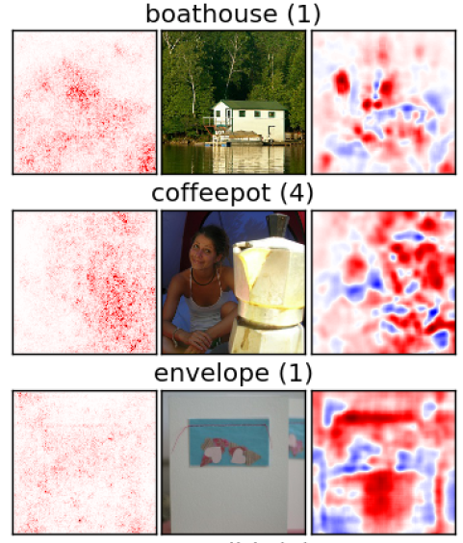
Comparison to Class Saliency Visualization (Simonyan et al, 2013)
The coffeepot is the only image that’s
incorrectly classified

Slide 60
Future Work
Find more sophisticated yet still efficient model for conditional sampling; downweigh pixels that are easily predictable from their neighbors
Use better classification algorithm for medical analysis
Visualization results using interactive 3D model
This method requires significant computational resources, so reduce pre-computation time using more powerful GPUs and optimization techniques

Slide 61
END

